Slide 1
Interpersonal

Slide 2
Types of relationships
Acquaintances
  People we know by name and talk with when the opportunity arises, but with whom our interactions are largely impersonal
Impersonal communication
  Interchangeable polite conversation that involves little personal disclosure

Slide 3
Friends
  People with whom we have negotiated more personal relationships that are voluntary
Intimates
  People with whom we share a high degree of commitment, trust, interdependence, disclosure and enjoyment
Platonic relationships
  Intimate relationship in which partners are not sexually attracted to each other or do not act on an attraction they feel
Romantic relationships
  Intimate relationship in which partners act on their sexual attraction

Slide 4
Trust
  Placing confidence in another in a way that almost always involves some risk
Intimacy guidelines
  Be dependable
  Responsiveness in meeting partner’s needs
  Collaborative in managing conflict
  Faithful
  Put relationship first
  Transparency through honesty

Slide 5
Disclosure and feedback
Self-disclosure
  Sharing biographical information, personal ideas and feelings that are unknown to the other person
Feedback
  Verbal and physical responses to people within the relationship
Johari window
  Tool for examining the relationship between disclosure and feedback in the relationship

Slide 6
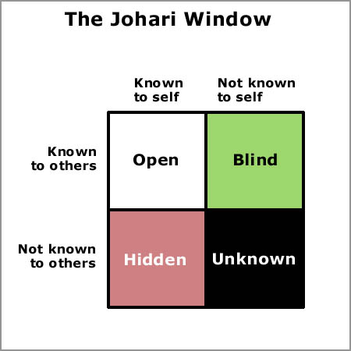

Slide 7
Open pane
  Information that both you and your partner know
Secret pane
  Things that you know about yourself but that your partner does not yet know about you
Blind pane
  The place for information that the other person knows about you, but about which you are unaware that they know
Unknown/secret pane
  Information that neither you nor your partner know about you
  New experiences

Slide 8
Size of each pane is negotiated through experience and feedback
balance of appropriate disclosure and feedback for both partners is a sign of a healthy relationship
Hiding information is problematic in a relationship

Slide 9
Communication in the stages of relationships
Beginning relationships
  Communication focuses on reducing uncertainty by increasing your knowledge of the other person
  Goal is to understand how he or she sees the world

Slide 10
Developing relationships
  As relationship develops, you disclose more to one another
  Engage in more physical contact
  Feel more psychologically close to the other person
Maintaining relationships
  Both people participate in ways that keep the relationship at a particular level of closeness
  Spending time together
  Face-to-face vs. online intimacy

Slide 11
Deteriorating and dissolving relationships
  Relationship becomes less satisfying to one or both partners
  Drifting apart occurs
  Less communication during this phase
  Relationships end when people no longer interact with one another
  Ending a relationship?

Slide 12
Dialectics in interpersonal relationships
Dialectic
  Tension between conflicting personal images one shows others
Relational dialectics
  Competing psychological tensions in a relationship

Slide 13
Autonomy-connection
  Autonomy is the desire to do things independent of one’s partner
  Connection is the desire to do things and make decisions with one’s partner
Openness-closedness
  Openness is the desire to share intimate ideas and feelings with one’s partner
  Closedness is the desire to maintain one’s privacy in a relationship
Novelty-predictability
  Novelty is the uniqueness in the partner’s relationship
  Predictability is the consistency, reliability and dependability in a relationship

Slide 14
Managing dialectical tensions
Temporal selection
  Strategy of choosing one dialectical tension and ignoring its opposite
  Spending more time together because of lack of connection
Topical segmentation
  Strategy of choosing certain topics to satisfy one dialectical tension
Neutralization
  Strategy of compromising between the desires of two partners
  Spontaneity in a relationship

Slide 15
Reframing
  Strategy of changing one’s perspective about the level of tension
  Discuss issues that bother one partner and determine whether those issues are as serious as perceived
  One partner communicates more openly than the other

Slide 16
Interpersonal communication skills
Comforting messages
Comforting
  Helping people feel better about themselves, behavior or situation by providing a safe conversational space
Buffering messages
  Comforting messages that are phrased very positively in ways that address another person’s face needs
Positive face needs
  Desire to for appreciation or approval

Slide 17
Disclosure in relationships
Disclosure
  Revealing confidential information about oneself or others
Privacy
  Right of an individual to keep information secret
Privacy management
  Exercising personal control over confidential information

Slide 18
Types of behavior
Passive
  Not expressing an opinion because we fear the cost of expressing such an opinion
Aggressive
  Belligerently confronting another with your preferences with little disregard for the feelings of others
Assertive
  Expressing your personal preferences while respecting the preferences of others

Slide 19
Styles of conflict
Withdrawing
  Managing conflict by removing yourself physically or emotionally
Accommodating
  Managing conflict by accepting what other want or need and ignoring your own wants or needs
Forcing
  Managing conflict by forcing your wants and needs on another person
Compromising
  Managing conflict by giving up part of what you want to satisfy the other

